Slide 1
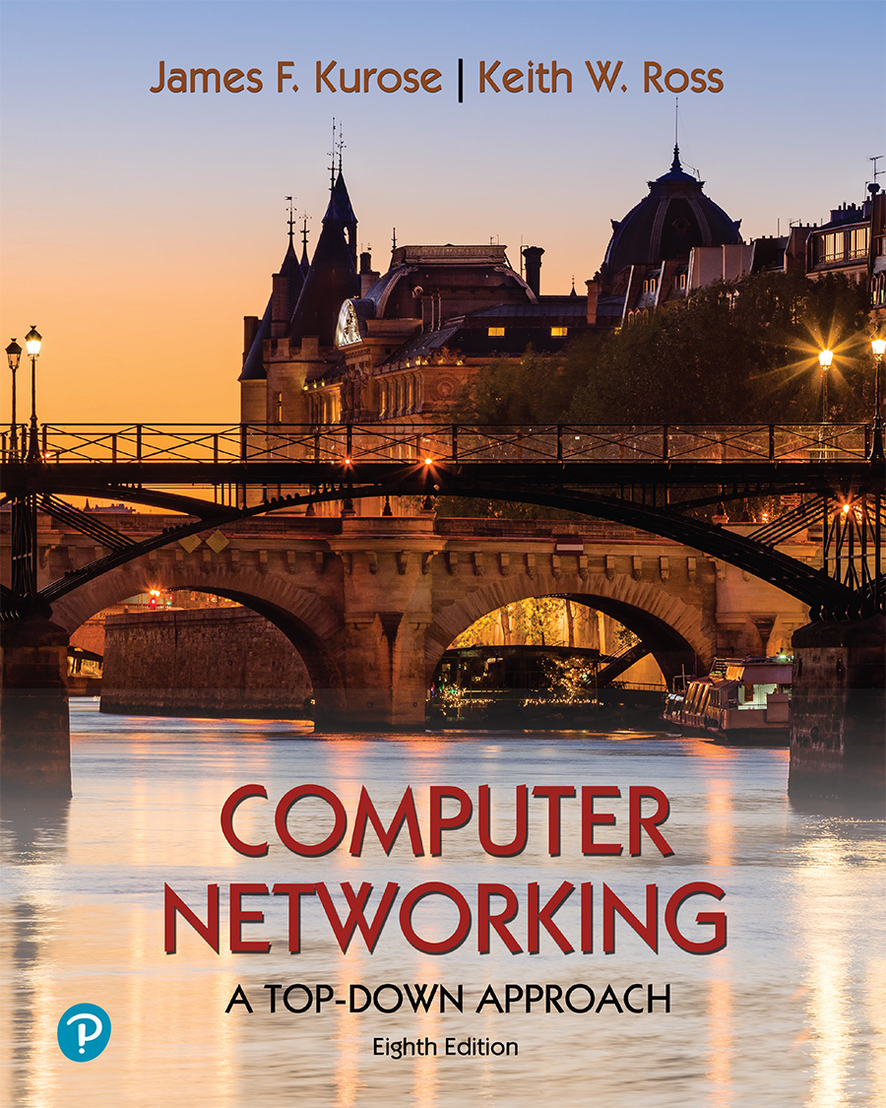
Chapter 5 Network Layer:
Control Plane
A note on the use of these PowerPoint slides:
We’re making these slides freely available to all (faculty, students, readers). They’re in PowerPoint form so you see the animations; and can add, modify, and delete slides (including this one) and slide content to suit your needs. They obviously represent a lot of work on our part. In return for use, we only ask the following:
If you use these slides (e.g., in a class) that you mention their source (after all, we’d like people to use our book!)
If you post any slides on a www site, that you note that they are adapted from (or perhaps identical to) our slides, and note our copyright of this material.
For a revision history, see the slide note for this page.
Thanks and enjoy! JFK/KWR
All material copyright 1996-2023
J.F Kurose and K.W. Ross, All Rights Reserved
Computer Networking: A Top-Down Approach 8th edition Jim Kurose, Keith Ross Pearson, 2020
Notes:
Version History
8.0 (May 2020)
All slides reformatted for 16:9 aspect ratio
All slides updated to 8th edition material
Use of Calibri font, rather that Gill Sans MT
Add LOTS more animation throughout
lighter header font
Re-do of network management slides; redo of Bellman-Ford slides
8.2 (changes over 8.0)
improved animations of Dijkstra’s algorithm and Bellman Ford
various improvements to BGP
SDN: added Google Orion (2021 Google network SDN control plane)

Slide 2
Network layer control plane: our goals
understand principles behind network control plane:
traditional routing algorithms
SDN controllers
network management, configuration
instantiation, implementation in the Internet:
OSPF, BGP
Internet Control Message Protocol: ICMP

Slide 3

Network layer: “control plane” roadmap
introduction
routing protocols
link state
distance vector
intra-ISP routing: OSPF
routing among ISPs: BGP
SDN control plane
Internet Control Message Protocol

Slide 4
Network-layer functions
forwarding: move packets from router’s input to appropriate router output
data plane
routing: determine route taken by packets from source to destination
control plane
Two approaches to structuring network control plane:
per-router control (traditional)
logically centralized control (software defined networking)

Slide 5

Per-router control plane
Individual routing algorithm components in each and every router interact in the control plane
Routing
Algorithm
control
plane
data
plane
values in arriving
packet header
0111
1
3
2

Slide 6
Software-Defined Networking (SDN) control plane
Remote controller computes, installs forwarding tables in routers
Remote Controller
control
plane
data
plane
CA
CA
CA
CA
CA
values in arriving
packet header
0111
1
3
2

Slide 7
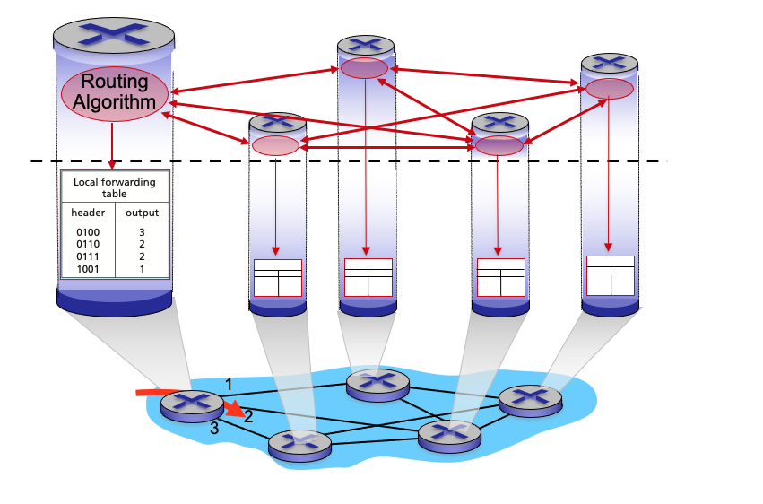
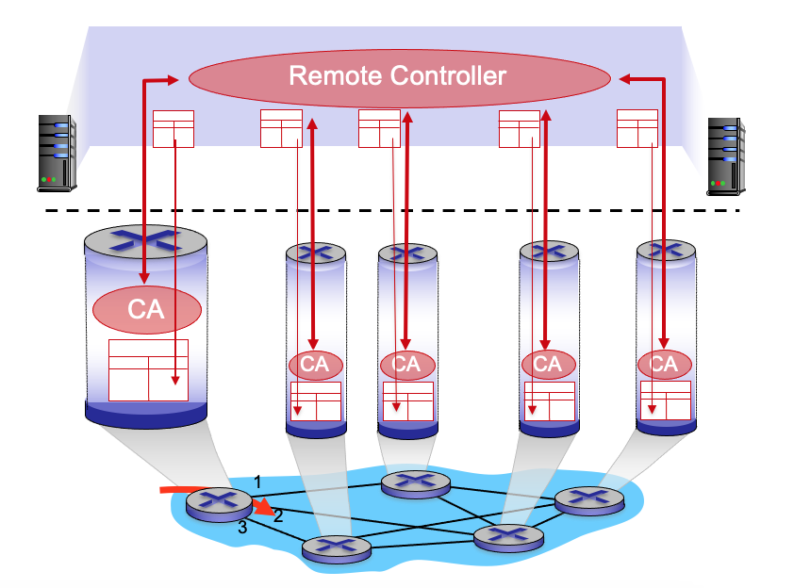
Per-router control plane
SDN control plane

Slide 8
Network layer: “control plane” roadmap
introduction
routing protocols
link state
distance vector
intra-ISP routing: OSPF
routing among ISPs: BGP
SDN control plane
Internet Control Message Protocol

Slide 9
















Routing protocols
mobile network
Routing protocol goal: determine “good” paths (equivalently, routes), from sending hosts to receiving host, through network of routers
path: sequence of routers packets traverse from given initial source host to final destination host
“good”: least “cost”, “fastest”, “least congested”
routing: a “top-10” networking challenge!
national or global ISP
application
transport
network
link
physical
network
link
physical
network
link
physical
network
link
physical
network
link
physical
network
link
physical
datacenter
network
application
transport
network
link
physical
enterprise
network

Slide 10
Graph abstraction: link costs
5
c_{a,b}: cost of direct link connecting a and b
e.g., c_{w,z} = 5, c_{u,z} = ∞
cost defined by network operator: could always be 1, or inversely related to bandwidth, or inversely related to congestion
v
3
w
2
5
u
2
1
z
3
1
2
x
y
1
graph: G = (N,E)
N: set of routers = { u, v, w, x, y, z }
E: set of links ={ (u,v), (u,x), (v,x), (v,w), (x,w), (x,y), (w,y), (w,z), (y,z) }

Slide 11
Routing algorithm classification
global: all routers have complete topology, link cost info
“link state” algorithms
dynamic: routes change more quickly
periodic updates or in response to link cost changes
How fast do routes change?
static: routes change slowly over time
decentralized: iterative process of computation, exchange of info with neighbors
routers initially only know link costs to attached neighbors
“distance vector” algorithms
global or decentralized information?

Slide 12
Network layer: “control plane” roadmap
introduction
routing protocols
link state
distance vector
intra-ISP routing: OSPF
routing among ISPs: BGP
SDN control plane
Internet Control Message Protocol

Slide 13
Dijkstra’s link-state routing algorithm
centralized: network topology, link costs known to all nodes
accomplished via “link state broadcast”
all nodes have same info
computes least cost paths from one node (“source”) to all other nodes
gives forwarding table for that node
iterative: after k iterations, know least cost path to k destinations
notation
c_{x,y}: direct link cost from node x to y; = ∞ if not direct neighbors
D(v): current estimate of cost of least-cost-path from source to destination v
p(v): predecessor node along path from source to v
N': set of nodes whose least-cost-path definitively known

Slide 14
Dijkstra’s link-state routing algorithm
1 Initialization:
2 N' = {u} /* compute least cost path from u to all other nodes */
3 for all nodes v
4 if v adjacent to u /* u initially knows direct-path-cost only to direct neighbors */
5 then D(v) = c_{u,v} /* but may not be minimum cost! */
6 else D(v) = ∞
7
8 Loop
9
10
11
12
13
14
15 until all nodes in N'
find w not in N' such that D(w) is a minimum
add w to N'
update D(v) for all v adjacent to w and not in N' :
D(v) = min ( D(v), D(w) + c_{w,v} )
/* new least-path-cost to v is either old least-cost-path to v or known
least-cost-path to w plus direct-cost from w to v */

Slide 15
Dijkstra’s algorithm: an example
v
w
x
y
z
Step
0
1
2
3
4
5
N'
D(v),p(v)
D(w),p(w)
D(x),p(x)
D(y),p(y)
D(z),p(z)
u
2,u
5,u
1,u
∞
∞
D(w),p(w)
5,u
4,x
3,y
3,y
5
Initialization (step 0):
For all a: if a adjacent to u then D(a) = c_{u,a}
v
3
w
2
5
u
2
1
z
3
1
2
x
y
1

Slide 16
Dijkstra’s algorithm: an example
v
w
x
y
z
Step
0
1
2
3
4
5
N'
D(v),p(v)
D(w),p(w)
D(x),p(x)
D(y),p(y)
D(z),p(z)
u
2,u
5,u
1,u
∞
∞
ux
D(w),p(w)
5,u
4,x
3,y
3,y
8 Loop
9
10
find a not in N' such that D(a) is a minimum
add a to N'
5
v
3
w
2
5
u
2
1
z
3
1
2
x
y
1

Slide 17

Dijkstra’s algorithm: an example
v
w
x
y
z
Step
0
1
2
3
4
5
N'
D(v),p(v)
D(w),p(w)
D(x),p(x)
D(y),p(y)
D(z),p(z)
u
2,u
5,u
1,u
∞
∞
ux
2,u
4,x
2,x
∞
D(w),p(w)
5,u
4,x
3,y
3,y
8 Loop
9
10
11
find a not in N' such that D(a) is a minimum
add a to N'
5
v
3
w
2
5
update D(b) for all b adjacent to a and not in N' :
D(b) = min ( D(b), D(a) + c_{a,b} )
u
2
1
z
3
1
2
D(v) = min ( D(v), D(x) + c_{x,v} ) = min(2, 1+2) = 2
x
y
1
D(w) = min ( D(w), D(x) + c_{x,w} ) = min (5, 1+3) = 4
D(y) = min ( D(y), D(x) + c_{x,y} ) = min(inf,1+1) = 2

Slide 18
Dijkstra’s algorithm: an example
v
w
x
y
z
Step
0
1
2
3
4
5
N'
D(v),p(v)
D(w),p(w)
D(x),p(x)
D(y),p(y)
D(z),p(z)
u
2,u
5,u
1,u
∞
∞
ux
2,u
4,x
2,x
∞
uxy
D(w),p(w)
5,u
4,x
3,y
3,y
8 Loop
9
10
find a not in N' such that D(a) is a minimum
add a to N'
5
v
3
w
2
5
u
2
1
z
3
1
2
x
y
1

Slide 19
Dijkstra’s algorithm: an example
v
w
x
y
z
Step
0
1
2
3
4
5
N'
D(v),p(v)
D(w),p(w)
D(x),p(x)
D(y),p(y)
D(z),p(z)
u
2,u
5,u
1,u
∞
∞
ux
2,u
4,x
2,x
∞
uxy
2,u
3,y
4,y
8 Loop
9
10
11
find a not in N' such that D(a) is a minimum
add a to N'
5
v
3
w
2
5
update D(b) for all b adjacent to a and not in N' :
D(b) = min ( D(b), D(a) + c_{a,b} )
u
2
1
z
3
1
2
D(w) = min ( D(w), D(y) + c_{y,w} ) = min (4, 2+1) = 3
x
y
1
D(z) = min ( D(z), D(y) + c_{y,z} ) = min(inf,2+2) = 4

Slide 20
Dijkstra’s algorithm: an example
v
w
x
y
z
Step
0
1
2
3
4
5
N'
D(v),p(v)
D(w),p(w)
D(x),p(x)
D(y),p(y)
D(z),p(z)
u
2,u
5,u
1,u
∞
∞
ux
2,u
4,x
2,x
∞
uxy
2,u
3,y
4,y
uxyv
8 Loop
9
10
find a not in N' such that D(a) is a minimum
add a to N'
5
v
3
w
2
5
u
2
1
z
3
1
2
x
y
1

Slide 21
Dijkstra’s algorithm: an example
v
w
x
y
z
Step
0
1
2
3
4
5
N'
D(v),p(v)
D(w),p(w)
D(x),p(x)
D(y),p(y)
D(z),p(z)
u
2,u
5,u
1,u
∞
∞
ux
2,u
4,x
2,x
∞
uxy
2,u
3,y
4,y
uxyv
3,y
4,y
8 Loop
9
10
11
find a not in N' such that D(a) is a minimum
add a to N'
5
v
3
w
2
5
update D(b) for all b adjacent to a and not in N' :
D(b) = min ( D(b), D(a) + c_{a,b} )
u
2
1
z
3
1
2
D(w) = min ( D(w), D(v) + c_{v,w} ) = min (3, 2+3) = 3
x
y
1

Slide 22
Dijkstra’s algorithm: an example
v
w
x
y
z
Step
0
1
2
3
4
5
N'
D(v),p(v)
D(w),p(w)
D(x),p(x)
D(y),p(y)
D(z),p(z)
u
2,u
5,u
1,u
∞
∞
ux
2,u
4,x
2,x
∞
uxy
2,u
3,y
4,y
uxyv
3,y
4,y
uxyvw
8 Loop
9
10
find a not in N' such that D(a) is a minimum
add a to N'
5
v
3
w
2
5
u
2
1
z
3
1
2
x
y
1

Slide 23
Dijkstra’s algorithm: an example
v
w
x
y
z
Step
0
1
2
3
4
5
N'
D(v),p(v)
D(w),p(w)
D(x),p(x)
D(y),p(y)
D(z),p(z)
u
2,u
5,u
1,u
∞
∞
ux
2,u
4,x
2,x
∞
uxy
2,u
3,y
4,y
uxyv
3,y
4,y
uxyvw
4,y
8 Loop
9
10
11
find a not in N' such that D(a) is a minimum
add a to N'
5
v
3
w
2
5
update D(b) for all b adjacent to a and not in N' :
D(b) = min ( D(b), D(a) + c_{a,b} )
u
2
1
z
3
1
2
D(z) = min ( D(z), D(w) + c_{w,z} ) = min (4, 3+5) = 4
x
y
1

Slide 24
Dijkstra’s algorithm: an example
v
w
x
y
z
Step
0
1
2
3
4
5
N'
D(v),p(v)
D(w),p(w)
D(x),p(x)
D(y),p(y)
D(z),p(z)
u
2,u
5,u
1,u
∞
∞
ux
2,u
4,x
2,x
∞
uxy
2,u
3,y
4,y
uxyv
3,y
4,y
uxyvw
4,y
uxyvwz
8 Loop
9
10
find a not in N' such that D(a) is a minimum
add a to N'
5
v
3
w
2
5
u
2
1
z
3
1
2
x
y
1

Slide 25
Dijkstra’s algorithm: an example
v
w
x
y
z
Step
0
1
2
3
4
5
N'
D(v),p(v)
D(w),p(w)
D(x),p(x)
D(y),p(y)
D(z),p(z)
u
2,u
5,u
1,u
∞
∞
ux
2,u
4,x
2,x
∞
uxy
2,u
3,y
4,y
uxyv
3,y
4,y
uxyvw
4,y
uxyvwz
8 Loop
9
10
11
find a not in N' such that D(a) is a minimum
add a to N'
5
v
3
w
2
5
update D(b) for all b adjacent to a and not in N' :
D(b) = min ( D(b), D(a) + c_{a,b} )
u
2
1
z
3
1
2
x
y
1

Slide 26
Dijkstra’s algorithm: an example
v
w
x
y
z
Step
0
1
2
3
4
5
N'
D(v),p(v)
D(w),p(w)
D(x),p(x)
D(y),p(y)
D(z),p(z)
u
2,u
5,u
1,u
∞
∞
ux
2,u
4,x
2,x
∞
uxy
2,u
3,y
4,y
uxyv
3,y
4,y
D(w),p(w)
5,u
4,x
3,y
3,y
uxyvw
4,y
uxyvwz
Initialization (step 0): For all a: if a adjacent to then D(a) = c_{u,a}
5
find a not in N' such that D(a) is a minimum
add a to N'
update D(b) for all b adjacent to a and not in N' :
D(b) = min ( D(b), D(a) + c_{a,b} )
v
3
w
2
5
u
2
1
z
3
1
2
x
y
1

Slide 27
Dijkstra’s algorithm: an example
5
v
3
w
2
5
u
2
1
z
3
1
2
D(w),p(w)
5,u
4,x
3,y
3,y
x
y
1
resulting least-cost-path tree from u:
resulting forwarding table in u:
v
w
destination
outgoing link
v
x
y
w
x
(u,v)
(u,x)
(u,x)
(u,x)
(u,x)
route from u to v directly
u
z
x
route from u to all other destinations via x
y

Slide 28
Dijkstra’s algorithm: another example
v
w
x
y
z
x
D(v),
p(v)
D(w),
p(w)
D(x),
p(x)
D(y),
p(y)
D(z),
p(z)
9
Step
N'
0
u
7,u
3,u
5,u
∞
∞
5
7
4
1
uw
6,w
5,u
11,w
∞
8
2
uwx
6,w
11,w
14,x
u
3
w
y
z
2
3
uwxv
10,v
14,x
3
4
uwxvy
12,y
7
4
5
uwxvyz
v
notes:
construct least-cost-path tree by tracing predecessor nodes
ties can exist (can be broken arbitrarily)

Slide 29
Dijkstra’s algorithm: discussion
algorithm complexity: n nodes
each of n iteration: need to check all nodes, w, not in N
n(n+1)/2 comparisons: O(n²) complexity
more efficient implementations possible: O(nlogn)
message complexity:
each router must broadcast its link state information to other n routers
efficient (and interesting!) broadcast algorithms: O(n) link crossings to disseminate a broadcast message from one source
each router’s message crosses O(n) links: overall message complexity: O(n²)

Slide 30
Network layer: “control plane” roadmap
introduction
routing protocols
link state
distance vector
intra-ISP routing: OSPF
routing among ISPs: BGP
SDN control plane
Internet Control Message Protocol

Slide 31
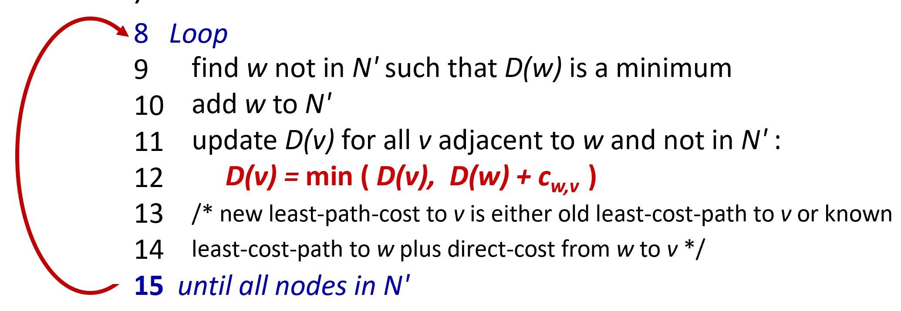
Distance vector algorithm
Based on Bellman-Ford (BF) equation (dynamic programming):
Bellman-Ford equation
Let D_{x}(y): cost of least-cost path from x to y.
Then:
D_{x}(y) = min_{v} { c_{x,v} + D_{v}(y) }
v’s estimated least-cost-path cost to y
min taken over all neighbors v of x
direct cost of link from x to v

Slide 32
Bellman-Ford Example
Suppose that u’s neighboring nodes, x,v,w, know that for destination z:
D_{v}(z) = 5
D_{w}(z) = 3
Bellman-Ford equation says:
5
D_{u}(z) = min { c_{u,v} + D_{v}(z),
c_{u,x} + D_{x}(z),
c_{u,w} + D_{w}(z) }
v
3
w
2
5
u
2
1
z
3
= min {2 + 5,
1 + 3,
5 + 3} = 4
1
2
x
y
1
D_{x}(z) = 3
node achieving minimum (x) is next hop on estimated least-cost path to destination (z)

Slide 33
Distance vector algorithm
key idea:
from time-to-time, each node sends its own distance vector estimate to neighbors
when x receives new DV estimate from any neighbor, it updates its own DV using B-F equation:
D_{x}(y) ← min_{v}{c_{x,v} + D_{v}(y)} for each node y ∊ N
under minor, natural conditions, the estimate D_{x}(y) converge to the actual least cost d_{x}(y)

Slide 34
Distance vector algorithm:
each node:
iterative, asynchronous: each local iteration caused by:
local link cost change
DV update message from neighbor
wait for (change in local link cost or msg from neighbor)
recompute DV estimates using DV received from neighbor
distributed, self-stopping: each node notifies neighbors only when its DV changes
neighbors then notify their neighbors – only if necessary
no notification received, no actions taken!
if DV to any destination has changed, notify neighbors

Slide 35
Distance vector: example
DV in a: D_{a}(a)=0
D_{a}(b) = 8
D_{a}(c) = ∞
D_{a}(d) = 1
D_{a}(e) = ∞
D_{a}(f) = ∞
D_{a}(g) = ∞
D_{a}(h) = ∞
D_{a}(i) = ∞
a
b
c
8
1
t=0
1
1
All nodes have distance estimates to nearest neighbors (only)
A few asymmetries:
missing link
larger cost
d
e
f
1
1
All nodes send their local distance vector to their neighbors
1
1
1
g
h
i
1
1

Slide 36
Distance vector example: iteration
a
b
c
8
1
t=1
1
1
All nodes:
receive distance vectors from neighbors
compute their new local distance vector
send their new local distance vector to neighbors
d
e
f
1
1
1
1
1
g
h
i
1
1

Slide 37
Distance vector example: iteration
a
compute
compute
compute
b
c
8
1
t=1
1
1
All nodes:
receive distance vectors from neighbors
compute their new local distance vector
send their new local distance vector to neighbors
d
compute
e
f
compute
compute
1
1
1
1
1
g
h
i
compute
compute
1
compute
1

Slide 38
Distance vector example: iteration
a
b
c
8
1
t=1
1
1
All nodes:
receive distance vectors from neighbors
compute their new local distance vector
send their new local distance vector to neighbors
d
e
f
1
1
1
1
1
g
h
i
1
1

Slide 39
Distance vector example: iteration
a
b
c
8
1
t=2
1
1
All nodes:
receive distance vectors from neighbors
compute their new local distance vector
send their new local distance vector to neighbors
d
e
f
1
1
1
1
1
g
h
i
1
1

Slide 40
Distance vector example: iteration
compute
compute
compute
a
b
c
2
1
t=2
1
1
All nodes:
receive distance vectors from neighbors
compute their new local distance vector
send their new local distance vector to neighbors
d
compute
compute
compute
e
f
1
1
1
1
1
g
compute
compute
compute
h
i
8
1

Slide 41
Distance vector example: iteration
a
b
c
8
1
t=2
1
1
All nodes:
receive distance vectors from neighbors
compute their new local distance vector
send their new local distance vector to neighbors
d
e
f
1
1
1
1
1
g
h
i
1
1

Slide 42
Distance vector example: iteration
…. and so on
Let’s next take a look at the iterative computations at nodes

Slide 43
Distance vector example: computation
DV in b:
DV in c:
D_{c}(a) = ∞
D_{c}(b) = 1
D_{c}(c) = 0
D_{c}(d) = ∞
D_{c}(e) = ∞
D_{c}(f) = ∞
D_{c}(g) = ∞
D_{c}(h) = ∞
D_{c}(i) = ∞
D_{b}(a) = 8
D_{b}(c) = 1
D_{b}(d) = ∞
D_{b}(e) = 1
D_{b}(f) = ∞
D_{b}(g) = ∞
D_{b}(h) = ∞
D_{b}(i) = ∞
DV in a: D_{a}(a)=0
D_{a}(b) = 8
D_{a}(c) = ∞
D_{a}(d) = 1
D_{a}(e) = ∞
D_{a}(f) = ∞
D_{a}(g) = ∞
D_{a}(h) = ∞
D_{a}(i) = ∞
a
b
c
8
1
t=1
1
1
b receives DVs from a, c, e
DV in e:
D_{e}(a) = ∞
D_{e}(b) = 1
D_{e}(c) = ∞
D_{e}(d) = 1
D_{e}(e) = 0
D_{e}(f) = 1
D_{e}(g) = ∞
D_{e}(h) = 1
D_{e}(i) = ∞
d
e
f
1
1
1
1
1
g
h
i
1
1

Slide 44
Distance vector example: computation
DV in b:
DV in c:
D_{c}(a) = ∞
D_{c}(b) = 1
D_{c}(c) = 0
D_{c}(d) = ∞
D_{c}(e) = ∞
D_{c}(f) = ∞
D_{c}(g) = ∞
D_{c}(h) = ∞
D_{c}(i) = ∞
D_{b}(a) = 8
D_{b}(c) = 1
D_{b}(d) = ∞
D_{b}(e) = 1
D_{b}(f) = ∞
D_{b}(g) = ∞
D_{b}(h) = ∞
D_{b}(i) = ∞
DV in a: D_{a}(a)=0
D_{a}(b) = 8
D_{a}(c) = ∞
D_{a}(d) = 1
D_{a}(e) = ∞
D_{a}(f) = ∞
D_{a}(g) = ∞
D_{a}(h) = ∞
D_{a}(i) = ∞
a
b
c
b
8
compute
1
t=1
1
1
b receives DVs from a, c, e, computes:
DV in e:
D_{e}(a) = ∞
D_{e}(b) = 1
D_{e}(c) = ∞
D_{e}(d) = 1
D_{e}(e) = 0
D_{e}(f) = 1
D_{e}(g) = ∞
D_{e}(h) = 1
D_{e}(i) = ∞
e
d
e
f
1
1
D_{b}(a) = min{c_{b,a}+D_{a}(a), c_{b,c} +D_{c}(a), c_{b,e}+D_{e}(a)} = min{8,∞,∞} = 8
D_{b}(c) = min{c_{b,a}+D_{a}(c), c_{b,c} +D_{c}(c), c _{b,e} +D_{e}(c)} = min{∞,1,∞} = 1
D_{b}(d) = min{c_{b,a}+D_{a}(d), c_{b,c} +D_{c}(d), c _{b,e} +D_{e}(d)} = min{9,2,∞} = 2
1
1
1
D_{b}(e) = min{c_{b,a}+D_{a}(e), c_{b,c} +D_{c}(e), c _{b,e} +D_{e}(e)} = min{∞,∞,1} = 1
DV in b:
D_{b}(f) = min{c_{b,a}+D_{a}(f), c_{b,c} +D_{c}(f), c _{b,e} +D_{e}(f)} = min{∞,∞,2} = 2
D_{b}(g) = min{c_{b,a}+D_{a}(g), c_{b,c} +D_{c}(g), c _{b,e}+D_{e}(g)} = min{∞, ∞, ∞} = ∞
D_{b}(a) = 8
D_{b}(c) = 1
D_{b}(d) = 2
D_{b}(e) = 1
D_{b}(f) =2
D_{b}(g) = ∞
D_{b}(h) = 2
D_{b}(i) = ∞
g
h
1
i
1
D_{b}(h) = min{c_{b,a}+D_{a}(h), c_{b,c} +D_{c}(h), c _{b,e}+D_{e}(h)} = min{∞, ∞, 2} = 2
D_{b}(i) = min{c_{b,a}+D_{a}(i), c_{b,c} +D_{c}(i), c _{b,e}+D_{e}(i)} = min{∞, ∞, ∞} = ∞

Slide 45
Distance vector example: computation
DV in b:
DV in c:
D_{c}(a) = ∞
D_{c}(b) = 1
D_{c}(c) = 0
D_{c}(d) = ∞
D_{c}(e) = ∞
D_{c}(f) = ∞
D_{c}(g) = ∞
D_{c}(h) = ∞
D_{c}(i) = ∞
D_{b}(a) = 8
D_{b}(c) = 1
D_{b}(d) = ∞
D_{b}(e) = 1
D_{b}(f) = ∞
D_{b}(g) = ∞
D_{b}(h) = ∞
D_{b}(i) = ∞
DV in a: D_{a}(a)=0
D_{a}(b) = 8
D_{a}(c) = ∞
D_{a}(d) = 1
D_{a}(e) = ∞
D_{a}(f) = ∞
D_{a}(g) = ∞
D_{a}(h) = ∞
D_{a}(i) = ∞
a
b
c
8
1
t=1
1
1
c receives DVs from b
DV in e:
D_{e}(a) = ∞
D_{e}(b) = 1
D_{e}(c) = ∞
D_{e}(d) = 1
D_{e}(e) = 0
D_{e}(f) = 1
D_{e}(g) = ∞
D_{e}(h) = 1
D_{e}(i) = ∞
d
e
f
1
1
1
1
1
g
h
i
1
1

Slide 46
Distance vector example: computation
DV in b:
DV in c:
D_{c}(a) = ∞
D_{c}(b) = 1
D_{c}(c) = 0
D_{c}(d) = ∞
D_{c}(e) = ∞
D_{c}(f) = ∞
D_{c}(g) = ∞
D_{c}(h) = ∞
D_{c}(i) = ∞
D_{b}(a) = 8
D_{b}(c) = 1
D_{b}(d) = ∞
D_{b}(e) = 1
D_{b}(f) = ∞
D_{b}(g) = ∞
D_{b}(h) = ∞
D_{b}(i) = ∞
a
b
c
1
compute
8
t=1
1
1
c receives DVs from b computes:
d
e
f
D_{c}(a) = min{c_{c,b}+D_{b}(a}} = 1 + 8 = 9
DV in c:
D_{c}(a) = 9
D_{c}(b) = 1
D_{c}(c) = 0
D_{c}(d) = 2
D_{c}(e) = ∞
D_{c}(f) = ∞
D_{c}(g) = ∞
D_{c}(h) = ∞
D_{c}(i) = ∞
D_{c}(b) = min{c_{c,b}+D_{b}(b)} = 1 + 0 = 1
D_{c}(d) = min{c_{c,b}+D_{b}(d)} = 1+ ∞ = ∞
D_{c}(e) = min{c_{c,b}+D_{b}(e)} = 1 + 1 = 2
D_{c}(f) = min{c_{c,b}+D_{b}(f)} = 1+ ∞ = ∞
D_{c}(g) = min{c_{c,b}+D_{b}(g)} = 1+ ∞ = ∞
* Check out the online interactive exercises for more examples: http://gaia.cs.umass.edu/kurose_ross/interactive/
g
h
i
D_{c}(h) = min{c_{bc,b}+D_{b}(h)} = 1+ ∞ = ∞
D_{c}(i) = min{c_{c,b}+D_{b}(i)} = 1+ ∞ = ∞

Slide 47
Distance vector example: computation
DV in b:
D_{b}(a) = 8
D_{b}(c) = 1
D_{b}(d) = ∞
D_{b}(e) = 1
D_{b}(f) = ∞
D_{b}(g) = ∞
D_{b}(h) = ∞
D_{b}(i) = ∞
DV in e:
D_{e}(a) = ∞
D_{e}(b) = 1
D_{e}(c) = ∞
D_{e}(d) = 1
D_{e}(e) = 0
D_{e}(f) = 1
D_{e}(g) = ∞
D_{e}(h) = 1
D_{e}(i) = ∞
DV in d:
D_{c}(a) = 1
D_{c}(b) = ∞
D_{c}(c) = ∞
D_{c}(d) = 0
D_{c}(e) = 1
D_{c}(f) = ∞ D_{c}(g) = 1
D_{c}(h) = ∞
D_{c}(i) = ∞
a
b
c
8
1
t=1
Q: what is new DV computed in e at t=1?
1
1
e receives DVs from b, d, f, h
d
compute
f
DV in f:
D_{c}(a) = ∞
D_{c}(b) = ∞
D_{c}(c) = ∞
D_{c}(d) = ∞
D_{c}(e) = 1
D_{c}(f) = 0
D_{c}(g) = ∞
D_{c}(h) = ∞
D_{c}(i) = 1
e
DV in h:
D_{c}(a) = ∞
D_{c}(b) = ∞
D_{c}(c) = ∞
D_{c}(d) = ∞
D_{c}(e) = 1
D_{c}(f) = ∞
D_{c}(g) = 1
D_{c}(h) = 0
D_{c}(i) = 1
1
1
1
1
1
g
h
i
1
1

Slide 48
Distance vector: state information diffusion
Iterative communication, computation steps diffuses information through network:
t=0
c’s state at t=0 is at c only
a
b
c
8
1
c’s state at t=0 has propagated to b, and may influence distance vector computations up to 1 hop away, i.e., at b
t=1
1
1
t=1
t=2
c’s state at t=0 may now influence distance vector computations up to 2 hops away, i.e., at b and now at a, e as well
t=2
d
e
f
1
1
t=3
c’s state at t=0 may influence distance vector computations up to 3 hops away, i.e., at d, f, h
1
1
1
t=3
c’s state at t=0 may influence distance vector computations up to 4 hops away, i.e., at g, i
t=4
g
h
i
1
1
t=4

Slide 49
Distance vector: link cost changes
link cost changes:
node detects local link cost change
updates routing info, recalculates local DV
if DV changes, notify neighbors
1
y
4
1
x
z
50
t₀ : y detects link-cost change, updates its DV, informs its neighbors.
“good news
travels fast”
t₁ : z receives update from y, updates its DV, computes new least cost to x , sends its neighbors its DV.
t₂ : y receives z’s update, updates its DV. y’s least costs do not change, so y does not send a message to z.

Slide 50
Distance vector: link cost changes
link cost changes:
node detects local link cost change
“bad news travels slow” – count-to-infinity problem:
60
y
4
1
x
z
50
y sees direct link to x has new cost 60, but z has said it has a path at cost of 5. So y computes “my new cost to x will be 6, via z); notifies z of new cost of 6 to x.
z learns that path to x via y has new cost 6, so z computes “my new cost to x will be 7 via y), notifies y of new cost of 7 to x.
y learns that path to x via z has new cost 7, so y computes “my new cost to x will be 8 via y), notifies z of new cost of 8 to x.
z learns that path to x via y has new cost 8, so z computes “my new cost to x will be 9 via y), notifies y of new cost of 9 to x.
…
see text for solutions. Distributed algorithms are tricky!

Slide 51
Comparison of LS and DV algorithms
message complexity
LS: n routers, O(n²) messages sent
DV: exchange between neighbors; convergence time varies
robustness: what happens if router malfunctions, or is compromised?
LS:
router can advertise incorrect link cost
each router computes only its own table
DV:
DV router can advertise incorrect path cost (“I have a really low-cost path to everywhere”): black-holing
each router’s DV is used by others: error propagate thru network
speed of convergence
LS: O(n²) algorithm, O(n²) messages
may have oscillations
DV: convergence time varies
may have routing loops
count-to-infinity problem

Slide 52
Network layer: “control plane” roadmap
introduction
routing protocols
intra-ISP routing: OSPF
routing among ISPs: BGP
SDN control plane
Internet Control Message Protocol

Slide 53
Making routing scalable
our routing study thus far - idealized
all routers identical
network “flat”
… not true in practice
scale: billions of destinations:
can’t store all destinations in routing tables!
routing table exchange would swamp links!
administrative autonomy:
Internet: a network of networks
each network admin may want to control routing in its own network

Slide 54
Internet approach to scalable routing
aggregate routers into regions known as “autonomous systems” (AS) (a.k.a. “domains”)
intra-AS (aka “intra-domain”): routing among routers within same AS (“network”)
all routers in AS must run same intra-domain protocol
routers in different AS can run different intra-domain routing protocols
gateway router: at “edge” of its own AS, has link(s) to router(s) in other AS’es
inter-AS (aka “inter-domain”): routing among AS’es
gateways perform inter-domain routing (as well as intra-domain routing)

Slide 55
Interconnected ASes
forwarding table configured by intra- and inter-AS routing algorithms
Intra-AS
Routing
Inter-AS
Routing
intra-AS routing determine entries for destinations within AS
forwarding
table
inter-AS & intra-AS determine entries for external destinations
intra-AS
routing
3c
3a
inter-AS routing
2c
3b
2a
intra-AS
routing
1c
2b
AS3
intra-AS
routing
1a
1b
AS2
1d
AS1

Slide 56

Inter-AS routing: a role in intradomain forwarding
suppose router in AS1 receives datagram destined outside of AS1:
AS1 inter-domain routing must:
learn which destinations reachable through AS2, which through AS3
propagate this reachability info to all routers in AS1
router should forward packet to gateway router in AS1, but which one?
3c
3a
2c
other
networks
3b
2a
1c
2b
AS3
other
networks
1a
1b
AS2
1d
AS1

Slide 57
Intra-AS routing: routing within an AS
most common intra-AS routing protocols:
RIP: Routing Information Protocol [RFC 1723]
classic DV: DVs exchanged every 30 secs
no longer widely used
EIGRP: Enhanced Interior Gateway Routing Protocol
DV based
formerly Cisco-proprietary for decades (became open in 2013 [RFC 7868])
OSPF: Open Shortest Path First [RFC 2328]
link-state routing
IS-IS protocol (ISO standard, not RFC standard) essentially same as OSPF

Slide 58
OSPF (Open Shortest Path First) routing
“open”: publicly available
classic link-state
each router floods OSPF link-state advertisements (directly over IP rather than using TCP/UDP) to all other routers in entire AS
multiple link costs metrics possible: bandwidth, delay
each router has full topology, uses Dijkstra’s algorithm to compute forwarding table
security: all OSPF messages authenticated (to prevent malicious intrusion)

Slide 59
Hierarchical OSPF
two-level hierarchy: local area, backbone.
link-state advertisements flooded only in area, or backbone
each node has detailed area topology; only knows direction to reach other destinations
area border routers: “summarize” distances to destinations in own area, advertise in backbone
boundary router: connects to other ASes
backbone
backbone router: runs OSPF limited to backbone
local routers:
flood LS in area only
compute routing within area
forward packets to outside via area border router
area 3
internal
routers
area 1
area 2

Slide 60
Network layer: “control plane” roadmap
introduction
routing protocols
intra-ISP routing: OSPF
routing among ISPs: BGP
SDN control plane
Internet Control Message Protocol

Slide 61

Interconnected ASes
intra-AS
routing
3c
3a
inter-AS routing
2c
3b
2a
intra-AS
routing
1c
2b
AS3
intra-AS
routing
1a
1b
AS2
1d
AS1
intra-AS (aka “intra-domain”): routing among routers within same AS (“network”)
inter-AS (aka “inter-domain”): routing among AS’es
Notes:
Each router then locally runs Dijkstra’s shortest-path algorithm to determine a shortest-path tree to all subnets, with itself as the root node.

Slide 62
Internet inter-AS routing: BGP
BGP (Border Gateway Protocol): the de facto inter-domain routing protocol
“glue that holds the Internet together”
allows subnet to advertise its existence, and the destinations it can reach, to rest of Internet: “I am here, here is who I can reach, and how”
BGP provides each AS a means to:
obtain destination network reachability info from neighboring ASes (eBGP)
determine routes to other networks based on reachability information and policy
propagate reachability information to all AS-internal routers (iBGP)
advertise (to neighboring networks) destination reachability info
Notes:
Since an inter-AS routing protocol involves coordination among multiple ASs, communicating ASs must run the same inter-AS routing protocol. In fact, in the Internet, all ASs run the same inter-AS routing protocol, called the Border Gateway Protocol, more commonly known as BGP

Slide 63
BGP protocol messages
BGP messages exchanged between peers over TCP connection
BGP messages [RFC 4371]:
OPEN: opens TCP connection to remote BGP peer and authenticates sending BGP peer
UPDATE: advertises new path (or withdraws old)
KEEPALIVE: keeps connection alive in absence of UPDATES; also ACKs OPEN request
NOTIFICATION: reports errors in previous msg; also used to close connection

Slide 64
Why different Intra-, Inter-AS routing ?
policy:
inter-AS: admin wants control over how its traffic routed, who routes through its network
intra-AS: single admin, so policy less of an issue
scale:
hierarchical routing saves table size, reduced update traffic
performance:
intra-AS: can focus on performance
inter-AS: policy dominates over performance

Slide 65
Comparison Between Routing Algorithms
协议 | 类型 | 算法 | 内容简介 | 特点 | 优点 | 缺点 | 适用场景
RIP | 域内 （距离向量） | Bellman-Ford | 基于跳数选择路径（最大15跳），定期广播路由表 | 简单易配置，适合小型网络 | 实现简单，资源消耗低 | 收敛慢，跳数限制 | 小型局域网/企业网络
OSPF | 域内 （链路状态） | Dijkstra | 基于带宽计算最短路径，分层设计，触发更新 | 快速收敛，支持大规模网络 | 高效灵活，支持复杂拓扑 | 配置复杂，资源消耗高 | 中大型企业网/运营商网络
BGP | 域间 （路径向量） | 路径向量 | 基于AS_PATH和策略的路由选择 | 策略控制灵活 | 支持超大规模网络 | 配置复杂，收敛慢 | 跨AS互联

Slide 66
Network layer: “control plane” roadmap
introduction
routing protocols
intra-ISP routing: OSPF
routing among ISPs: BGP
SDN control plane
Internet Control Message Protocol
network management, configuration
SNMP
NETCONF/YANG

Slide 67
Software defined networking (SDN)
Internet network layer: historically implemented via distributed, per-router control approach:
monolithic router contains switching hardware, runs proprietary implementation of Internet standard protocols (IP, RIP, IS-IS, OSPF, BGP) in proprietary router OS (e.g., Cisco IOS)
different “middleboxes” for different network layer functions: firewalls, load balancers, NAT boxes, ..
~2005: renewed interest in rethinking network control plane

Slide 68
Per-router control plane
Individual routing algorithm components in each and every router interact in the control plane to computer forwarding tables
Routing
Algorithm
control
plane
data
plane
values in arriving
packet header
0111
1
3
2

Slide 69
Software-Defined Networking (SDN) control plane
Remote controller computes, installs forwarding tables in routers
Remote Controller
control
plane
data
plane
CA
CA
CA
CA
CA
values in arriving
packet header
0111
1
3
2

Slide 70
Software defined networking (SDN)
Why a logically centralized control plane?
easier network management: avoid router misconfigurations, greater flexibility of traffic flows
table-based forwarding (recall OpenFlow API) allows “programming” routers
centralized “programming” easier: compute tables centrally and distribute
distributed “programming” more difficult: compute tables as result of distributed algorithm (protocol) implemented in each-and-every router
open (non-proprietary) implementation of control plane
foster innovation: let 1000 flowers bloom

Slide 71





SDN analogy: mainframe to PC revolution
App
App
App
App
App
App
App
App
App
App
App
Specialized
Applications
Open Interface
Specialized
Operating
System
or
or
Windows
Linux
MAC OS
Specialized
Hardware
Open Interface
Microprocessor
Vertically integrated
Closed, proprietary
Slow innovation
Small industry
Horizontal
Open interfaces
Rapid innovation
Huge industry
* Slide courtesy: N. McKeown

Slide 72

Traffic engineering: difficult with traditional routing
5
3
v
w
5
2
u
2
1
z
3
1
2
x
y
1
Q: what if network operator wants u-to-z traffic to flow along uvwz, rather than uxyz?
A: need to re-define link weights so traffic routing algorithm computes routes accordingly (or need a new routing algorithm)!
link weights are only control “knobs”: not much control!

Slide 73
Traffic engineering: difficult with traditional routing
5
3
v
w
5
2
u
2
1
z
3
1
2
x
y
1
Q: what if network operator wants to split u-to-z traffic along uvwz and uxyz (load balancing)?
A: can’t do it (or need a new routing algorithm)

Slide 74
Traffic engineering: difficult with traditional routing
5
3
v
w
5
2
u
2
1
z
3
1
2
x
y
1
Q: what if w wants to route blue and red traffic differently from w to z?
A: can’t do it (with destination-based forwarding, and LS, DV routing)
We learned in Chapter 4 that generalized forwarding and SDN can be used to achieve any routing desired

Slide 75
Software defined networking (SDN)
…
3. control plane functions external to data-plane switches
4. programmable control applications
routing
access control
load
balance
Remote Controller
control
plane
data
plane
CA
2. control, data plane separation
CA
CA
CA
CA
1: generalized “flow-based” forwarding (e.g., OpenFlow)

Slide 76
Software defined networking (SDN)
Data-plane switches:
fast, simple, commodity switches implementing generalized data-plane forwarding (Section 4.4) in hardware
flow (forwarding) table computed, installed under controller supervision
API for table-based switch control (e.g., OpenFlow)
defines what is controllable, what is not
protocol for communicating with controller (e.g., OpenFlow)
network-control applications
…
routing
access
control
load
balance
control
plane
northbound API
SDN Controller
(network operating system)
southbound API
data
plane
SDN-controlled switches

Slide 77
Software defined networking (SDN)
SDN controller (network OS):
maintain network state information
interacts with network control applications “above” via northbound API
interacts with network switches “below” via southbound API
implemented as distributed system for performance, scalability, fault-tolerance, robustness
network-control applications
…
routing
access
control
load
balance
control
plane
northbound API
SDN Controller
(network operating system)
southbound API
data
plane
SDN-controlled switches

Slide 78
Software defined networking (SDN)
network-control apps:
“brains” of control: implement control functions using lower-level services, API provided by SDN controller
unbundled: can be provided by 3rd party: distinct from routing vendor, or SDN controller
network-control applications
…
routing
access
control
load
balance
control
plane
northbound API
SDN Controller
(network operating system)
southbound API
data
plane
SDN-controlled switches

Slide 79
Components of SDN controller
routing
access
control
load
balance
interface layer to network control apps: abstractions API
Interface, abstractions for network control apps
…
network graph
RESTful
API
intent
…
network-wide state management : state of networks links, switches, services: a distributed database
statistics
flow tables
SDN
controller
Network-wide distributed, robust state management
…
Link-state info
host info
switch info
…
communication: communicate between SDN controller and controlled switches
OpenFlow
SNMP
Communication to/from controlled devices

Slide 80

OpenFlow protocol
operates between controller, switch
TCP used to exchange messages
optional encryption
three classes of OpenFlow messages:
controller-to-switch
asynchronous (switch to controller)
symmetric (misc.)
distinct from OpenFlow API
API used to specify generalized forwarding actions
OpenFlow Controller

Slide 81
OpenFlow: controller-to-switch messages
Key controller-to-switch messages
features: controller queries switch features, switch replies
configure: controller queries/sets switch configuration parameters
modify-state: add, delete, modify flow entries in the OpenFlow tables
packet-out: controller can send this packet out of specific switch port
OpenFlow Controller

Slide 82
OpenFlow: switch-to-controller messages
Key switch-to-controller messages
packet-in: transfer packet (and its control) to controller. See packet-out message from controller
flow-removed: flow table entry deleted at switch
port status: inform controller of a change on a port.
OpenFlow Controller
Fortunately, network operators don’t “program” switches by creating/sending OpenFlow messages directly. Instead use higher-level abstraction at controller

Slide 83
SDN: control/data plane interaction example
Dijkstra’s link-state
routing
1
S1, experiencing link failure uses OpenFlow port status message to notify controller
4
…
network graph
RESTful
API
intent
3
…
2
SDN controller receives OpenFlow message, updates link status info
statistics
flow tables
…
Link-state info
host info
switch info
3
2
Dijkstra’s routing algorithm application has previously registered to be called when ever link status changes. It is called.
…
OpenFlow
SNMP
1
4
Dijkstra’s routing algorithm access network graph info, link state info in controller, computes new routes
s2
s1
s4
s3

Slide 84
SDN: control/data plane interaction example
Dijkstra’s link-state
routing
4
5
…
network graph
RESTful
API
intent
5
link state routing app interacts with flow-table-computation component in SDN controller, which computes new flow tables needed
3
…
statistics
flow tables
…
Link-state info
host info
switch info
2
…
OpenFlow
SNMP
6
controller uses OpenFlow to install new tables in switches that need updating
1
6
s2
s1
s4
s3

Slide 85
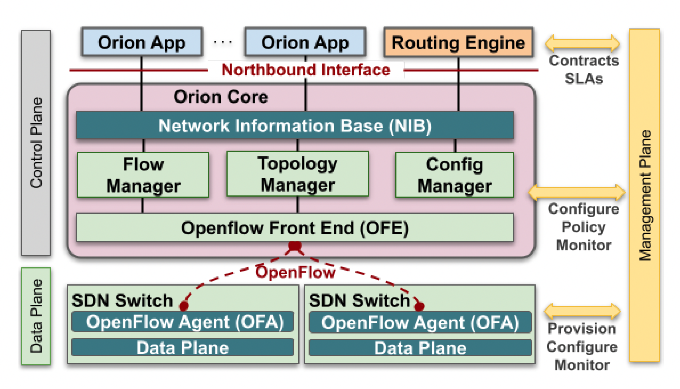
Google ORION SDN control plane
ORION: Google’s SDN control plane (NSDI’21): control plane for Google’s datacenter (Jupiter) and wide area (B4) networks
routing (intradomain, iBGP), traffic engineering: implemented in applications on top of ORION core
edge-edge flow-based controls (e.g., CoFlow scheduling) to meet contract SLAs
management: pub-sub distributed microservices in Orion core, OpenFlow for switch signaling/monitoring
Orion SDN architecture and core apps
Note: ORION provides intradomain services within Google’s network
Notes:
and so in this sense a migration away from “protocols” is indeed underway!
Explain structure of Orion in figure
Repeat after each reveal: no protocol
Coflows: “a collection of flows between two groups of machines with associated semantics and a collective objective”; [Sigcomm’13, Sigcomm’15, Sigcomm’18]. Not unlike multiprocessor scheduling in the 1980’s

Slide 86
OpenDaylight (ODL) controller
Traffic Engineering
…
Firewalling
Load Balancing
Network Orchestrations and Applications
Northbound API
REST/RESTCONF/NETCONF APIs
Enhanced Services
Basic Network Functions
…
Topology
processing
Switch
mgr.
Stats
mgr.
AAA
…
Forwarding rules mgr.
Host
Tracker
Service Abstraction Layer:
interconnects internal, external applications and services
config. and operational data store
messaging
Service Abstraction Layer (SAL)
…
Southbound API
OpenFlow
NETCONF
SNMP
OVSDB

Slide 87
ONOS controller
Traffic Engineering
…
Firewalling
Load Balancing
Network Applications
Northbound API
control apps separate from controller
intent framework: high-level specification of service: what rather than how
considerable emphasis on distributed core: service reliability, replication performance scaling
REST API
Intent
northbound abstractions,
protocols
hosts
paths
flow rules
topology
ONOS
distributed core
devices
links
statistics
device
link
host
flow
packet
southbound abstractions,
protocols
OpenFlow
Netconf
OVSDB
Southbound API

Slide 88
SDN: selected challenges
hardening the control plane: dependable, reliable, performance-scalable, secure distributed system
robustness to failures: leverage strong theory of reliable distributed system for control plane
dependability, security: “baked in” from day one?
networks, protocols meeting mission-specific requirements
e.g., real-time, ultra-reliable, ultra-secure
Internet-scaling: beyond a single AS
SDN critical in 5G cellular networks

Slide 89
SDN and the future of traditional network protocols
SDN-computed versus router-computer forwarding tables:
just one example of logically-centralized-computed versus protocol computed
one could imagine SDN-computed congestion control:
controller sets sender rates based on router-reported (to controller) congestion levels
How will implementation of network functionality (SDN versus protocols) evolve?

Slide 90
Network layer: “control plane” roadmap
introduction
routing protocols
intra-ISP routing: OSPF
routing among ISPs: BGP
SDN control plane
Internet Control Message Protocol

Slide 91
ICMP: internet control message protocol
used by hosts and routers to communicate network-level information
error reporting: unreachable host, network, port, protocol
echo request/reply (used by ping)
network-layer “above” IP:
ICMP messages carried in IP datagrams
ICMP message: type, code plus first 8 bytes of IP datagram causing error
Type Code description
0 0 echo reply (ping)
3 0 dest. network unreachable
3 1 dest host unreachable
3 2 dest protocol unreachable
3 3 dest port unreachable
3 6 dest network unknown
3 7 dest host unknown
4 0 source quench (congestion
control - not used)
8 0 echo request (ping)
9 0 route advertisement
10 0 router discovery
11 0 TTL expired
12 0 bad IP header

Slide 92

Traceroute and ICMP
3 probes
3 probes
3 probes
source sends sets of UDP segments to destination
1st set has TTL =1, 2nd set has TTL=2, etc.
datagram in nth set arrives to nth router:
router discards datagram and sends source ICMP message (type 11, code 0)
ICMP message possibly includes name of router & IP address
stopping criteria:
UDP segment eventually arrives at destination host
destination returns ICMP “port unreachable” message (type 3, code 3)
source stops
when ICMP message arrives at source: record RTTs

